Slide 1
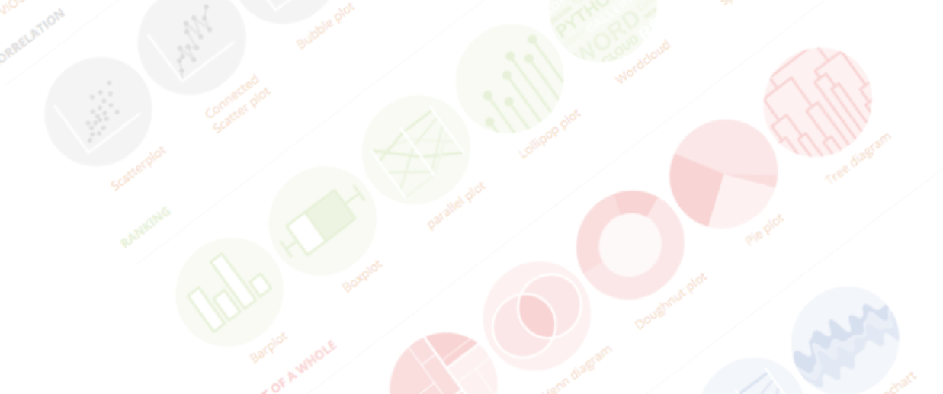
Introduction to data visualization
What, how, why, and more
Yan-holtz.com/teaching

Slide 2
What

Slide 3
Data Visualization (Dataviz)
=
Visual representation of data
Notes:
Dinéusorus

Slide 4
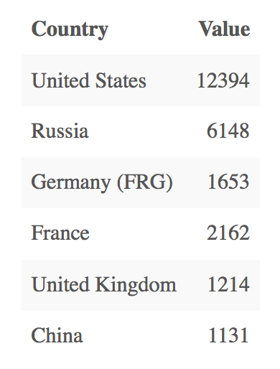
Who sells more weapons ?
Data

Slide 5
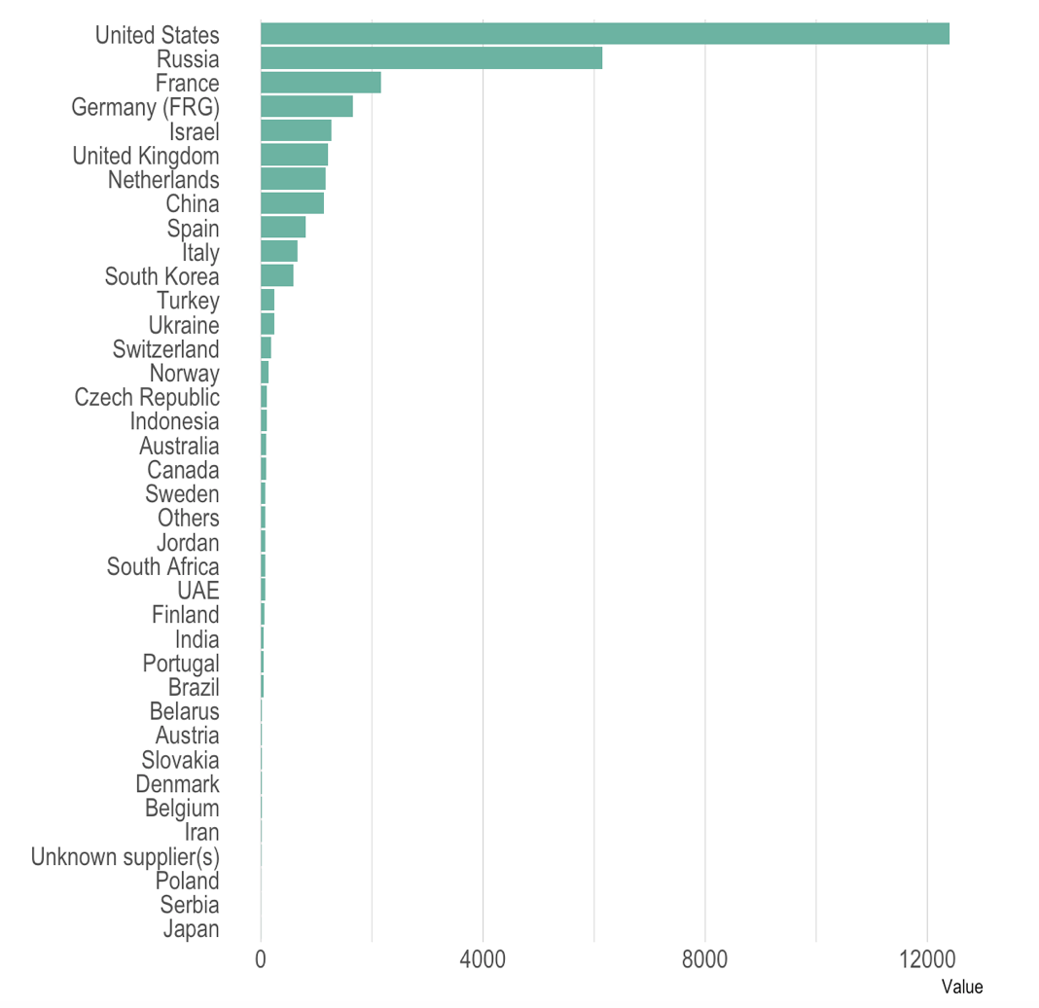
Who sells more weapons ?
Viz
Data

Slide 6
Dataviz = diversity
What kind of chart do you know?
Notes:
Dinéusorus

Slide 7

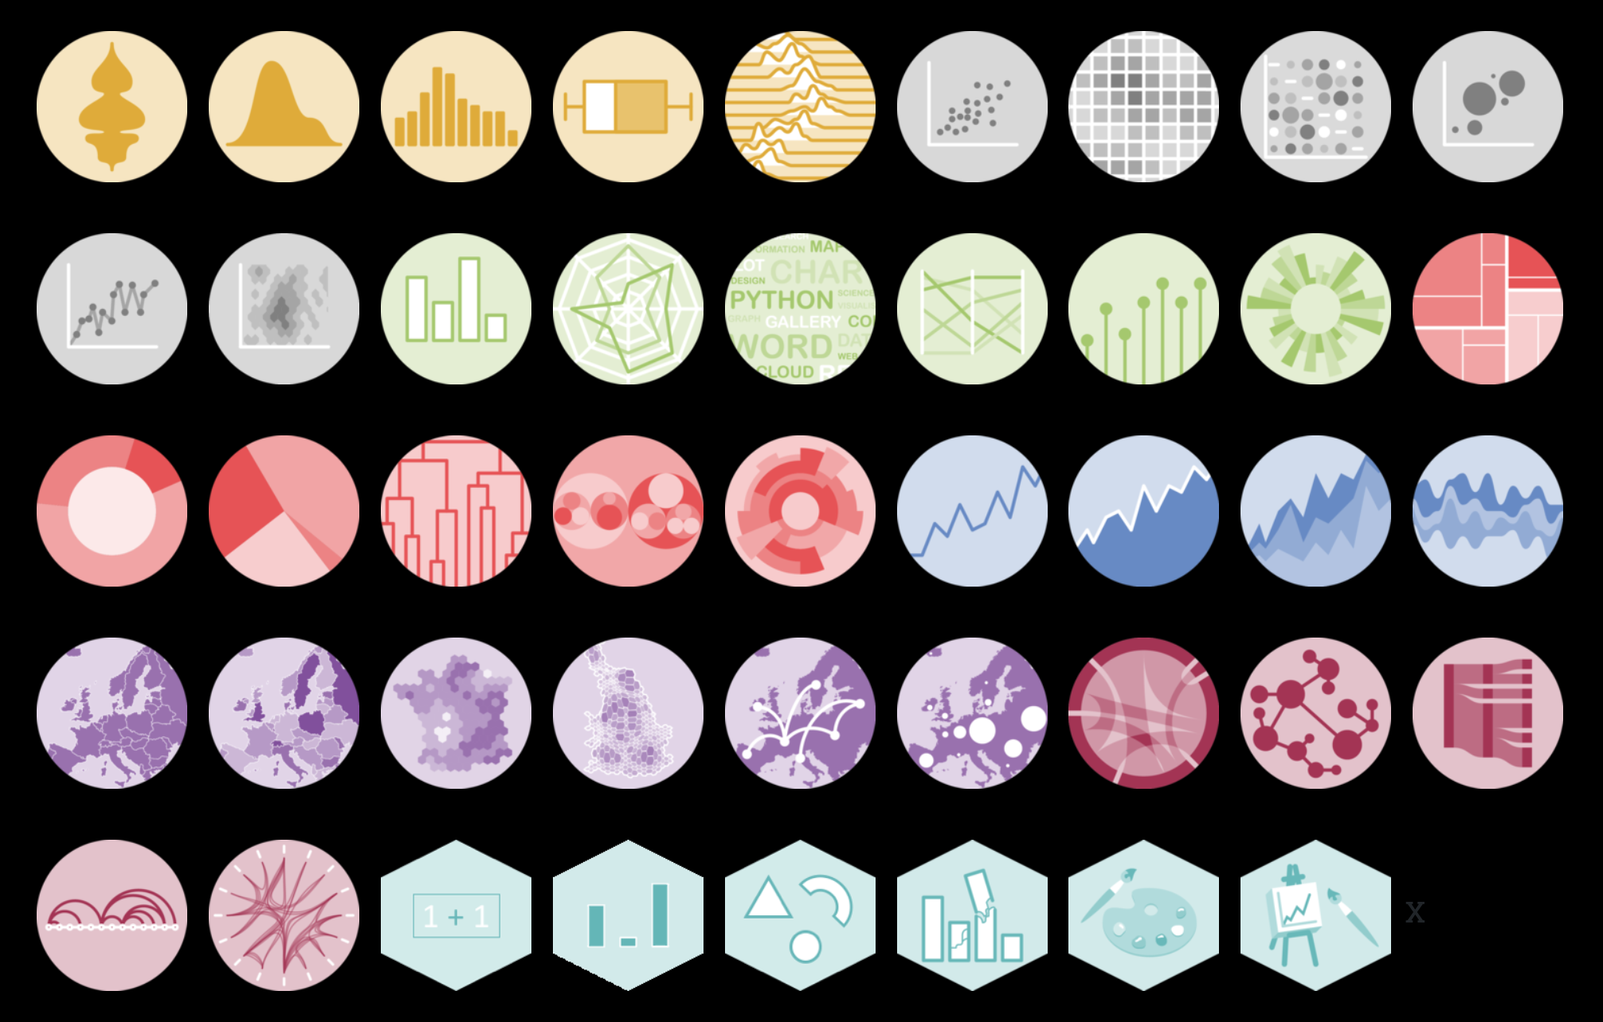

Slide 8
Dataviz > chart
Chart < Infographic < Interactivity < Dashboard < Story Telling
Notes:
Dinéusorus

Slide 9
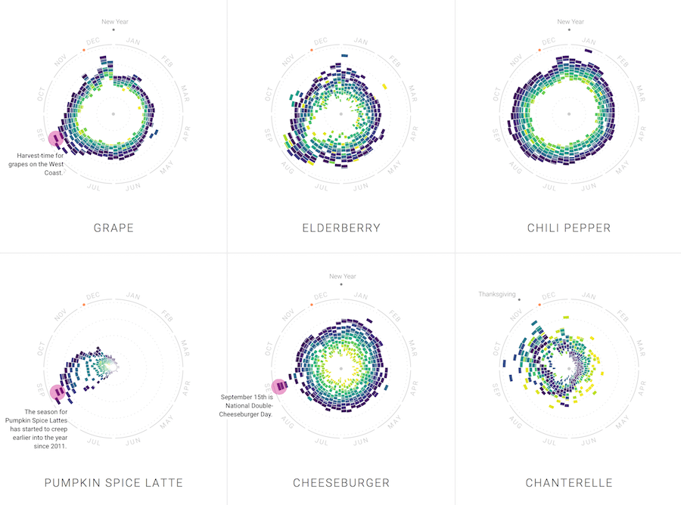
Flowing Data

Slide 10
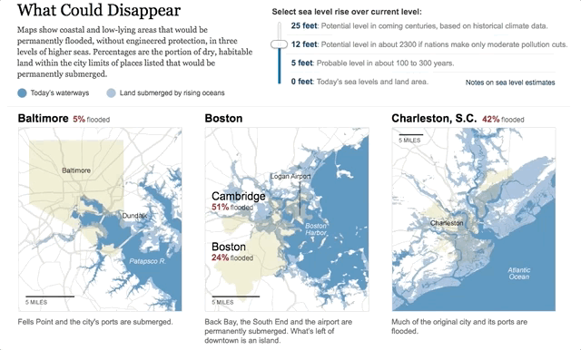
New York Times

Slide 11
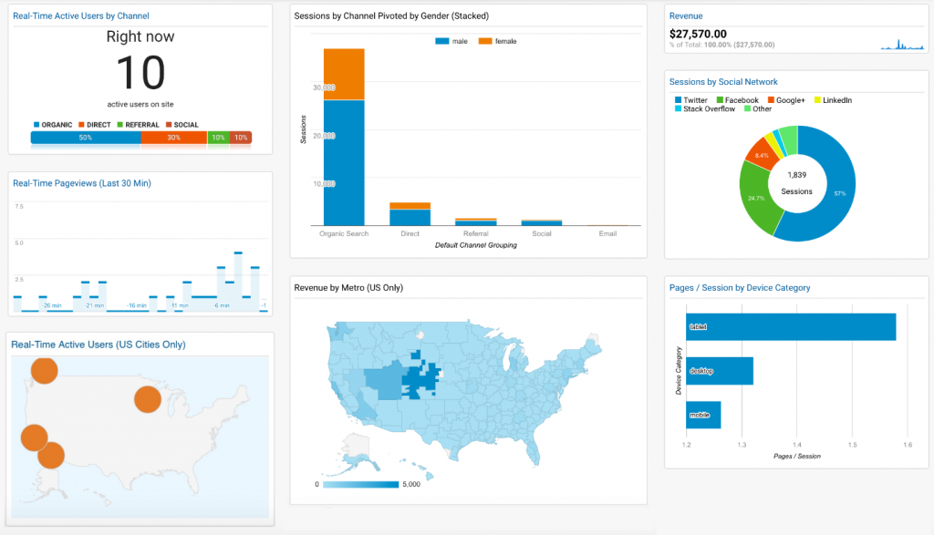
iDashboards

Slide 12
Story Telling with data: The Pudding
https://pudding.cool/2018/08/wiki-death/

Slide 13
Why
« A picture is worth a thousand words »

Slide 14
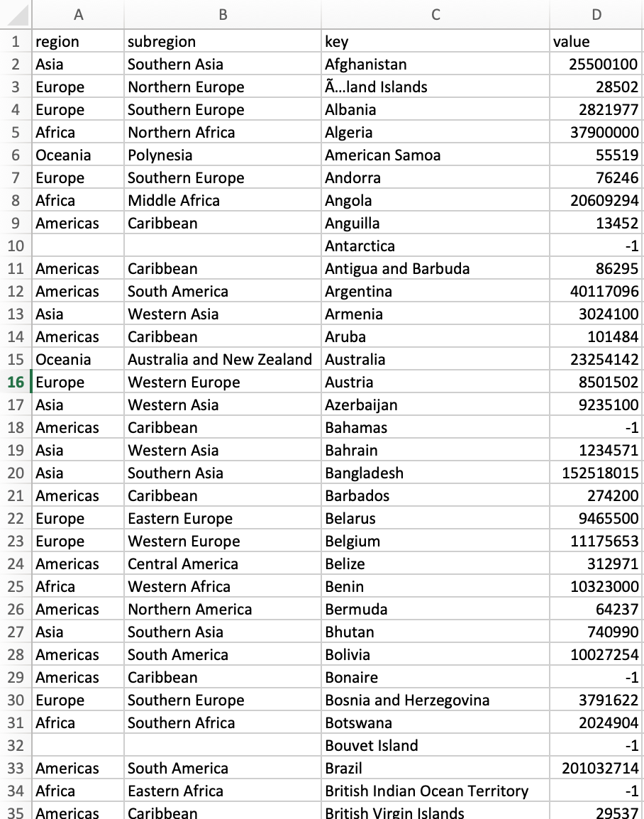

World population distribution
Biggest country?
Rank?
Distribution by continent?
Notes:
Dinéusorus

Slide 15
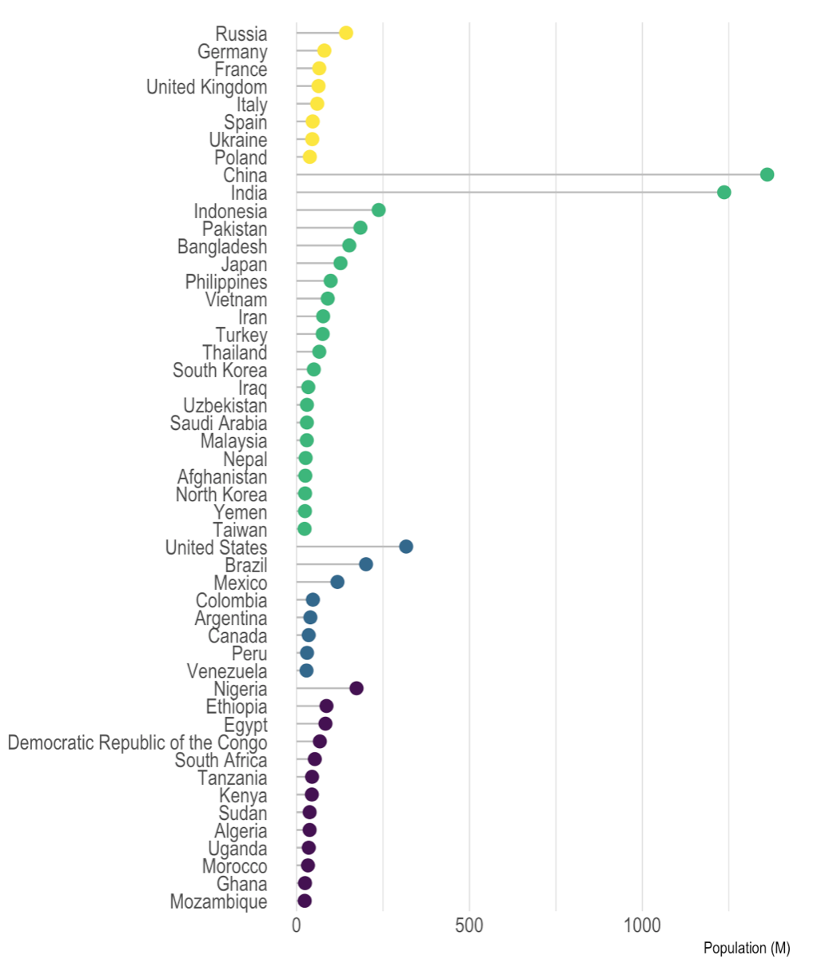
“Picture superiority effect”

Slide 16
Y = 3 + 0.5x
Cor = 0.8
Mean(x) = 9
Var(x) = 11
Mean(Y) = 7.5
Var(Y) = 4.1
OK, but we have summary statistics!
Anscombe's quartet
Anscombe et al. 1973
Notes:
Dinéusorus

Slide 17

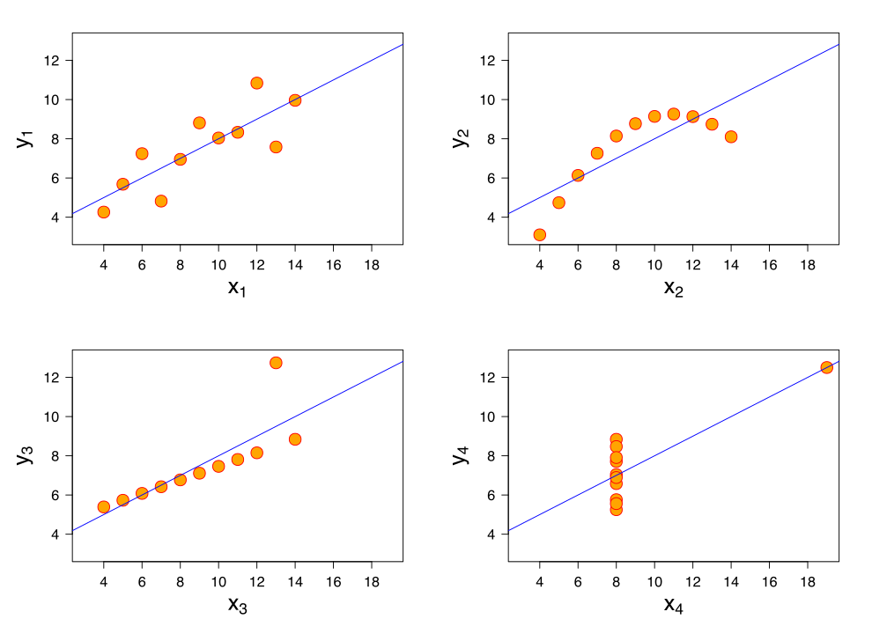
Y = 3 + 0.5x
Cor = 0.8
Mean(x) = 9
Var(x) = 11
Mean(Y) = 7.5
Var(Y) = 4.1
Notes:
Dinéusorus

Slide 18
Y = 3 + 0.5x
Cor = 0.8
Mean(x) = 9
Var(x) = 11
Mean(Y) = 7.5
Var(Y) = 4.1
Anscombe's quartet
Anscombe et al. 1973
Notes:
Dinéusorus

Slide 19
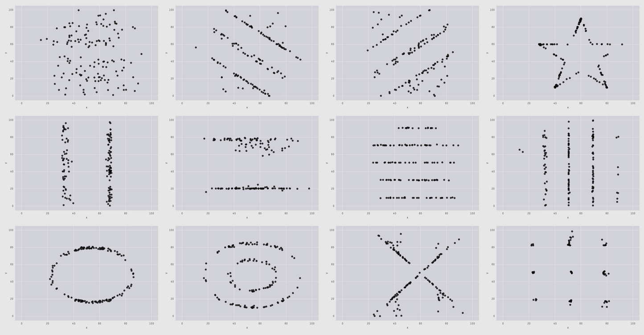
The Datasaurus Dozen
Cairo , 2017
Matejka & Fitzmaurice, 2017

Slide 20
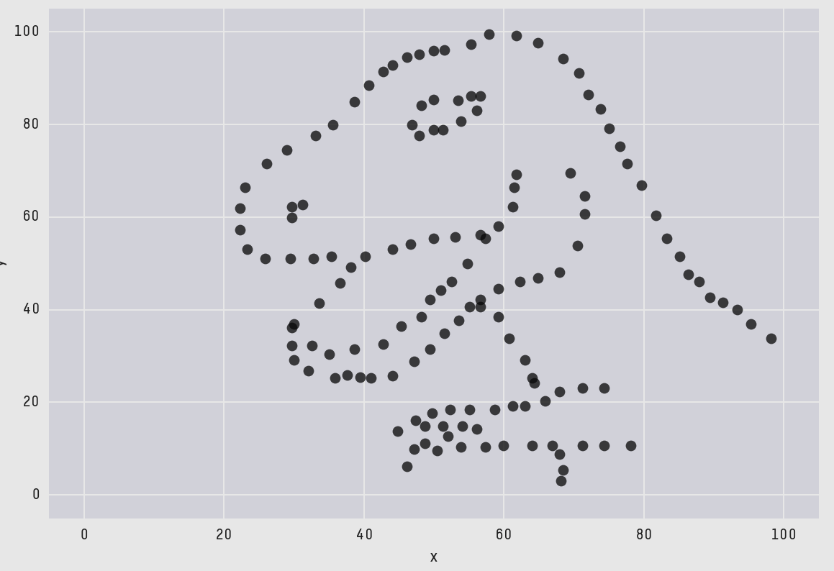
The Datasaurus Dozen
Cairo , 2017
Matejka & Fitzmaurice, 2017

Slide 21
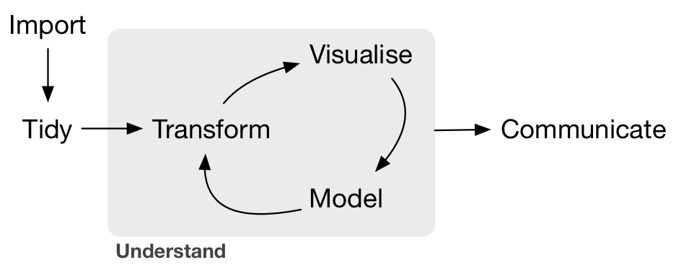
The Data Science Pipeline
R for Data Science, Whickam et al.
Notes:
Dinéusorus

Slide 22
2 main types of dataviz:
Exploratory
Explanatory
R for Data Science, Whickam et al.
Notes:
Dinéusorus

Slide 23
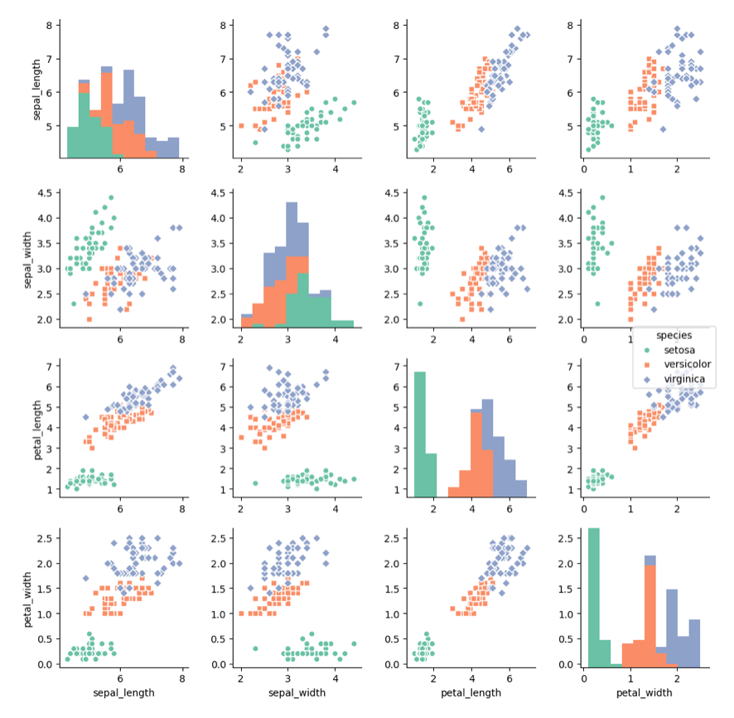
Exploratory
Understand data
Test hypothesis
Find results
Notes:
Dinéusorus

Slide 24
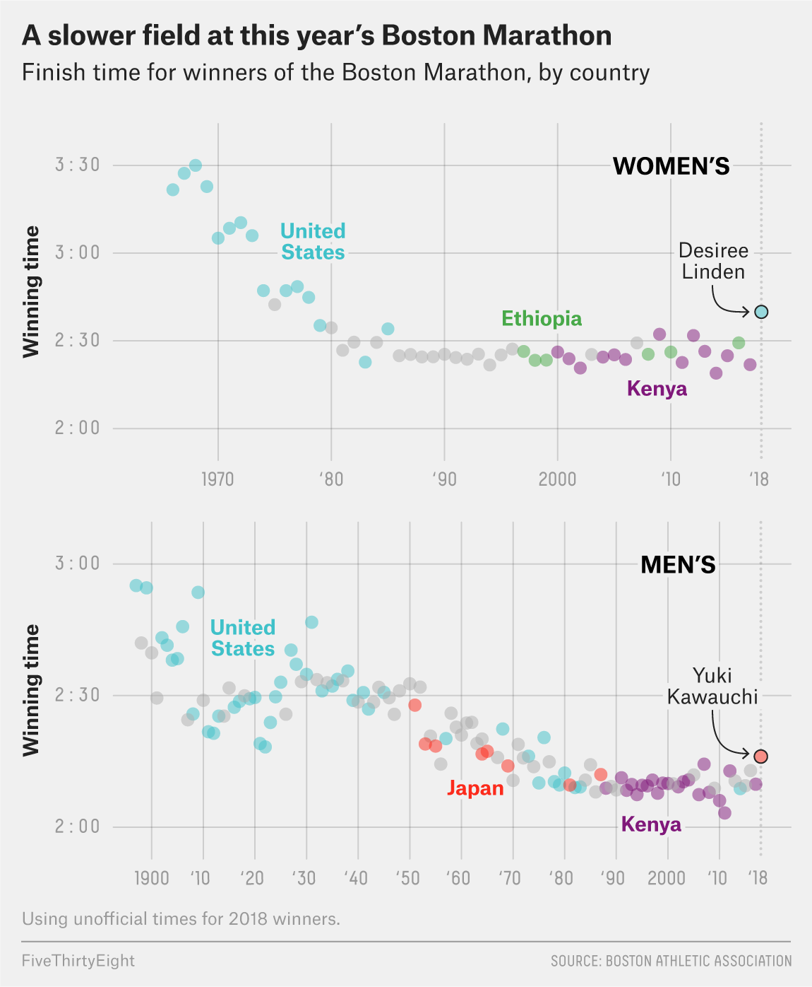
Explanatory
Communicate result
Show something specific
Tells a story
Five thirty height
Notes:
Dinéusorus

Slide 25
Building the right Viz

Slide 26
Looking for a chart ?
What you can do
What you should do
Caveats to avoid
How to
build it

Slide 27
Who sells more weapons ?
?
Notes:
Very simple dataset,
-> What would you do ?
quantity of weapons exported by the top 50 largest exporters in 2017.
on the Stockholm International Peace Research Institute

Slide 28
Who sells more weapons ?

Slide 29
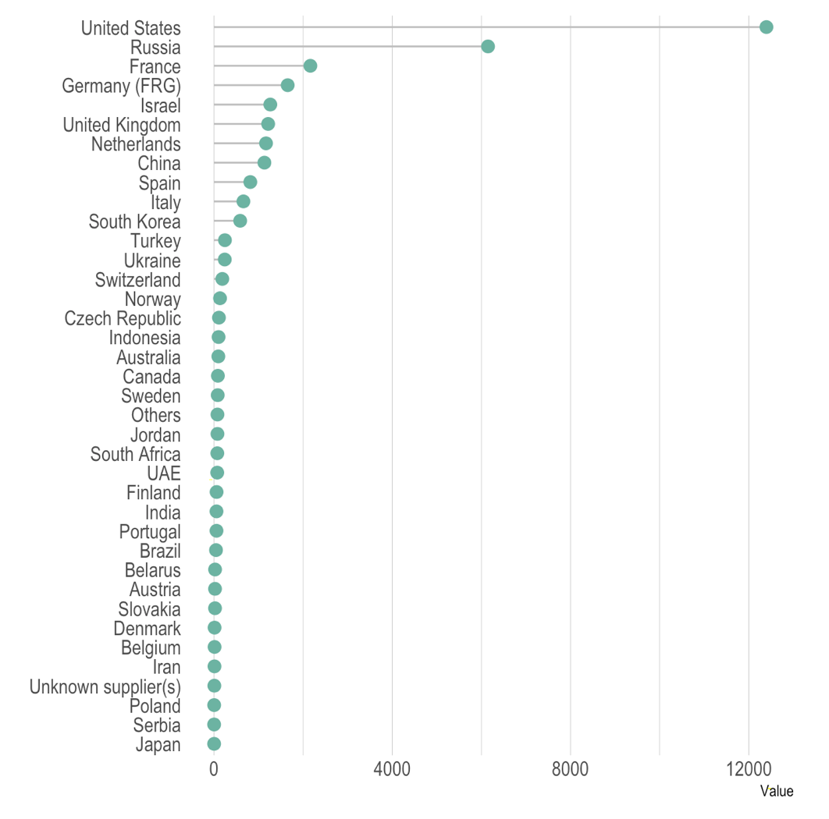
Who sells more weapons ?

Slide 30
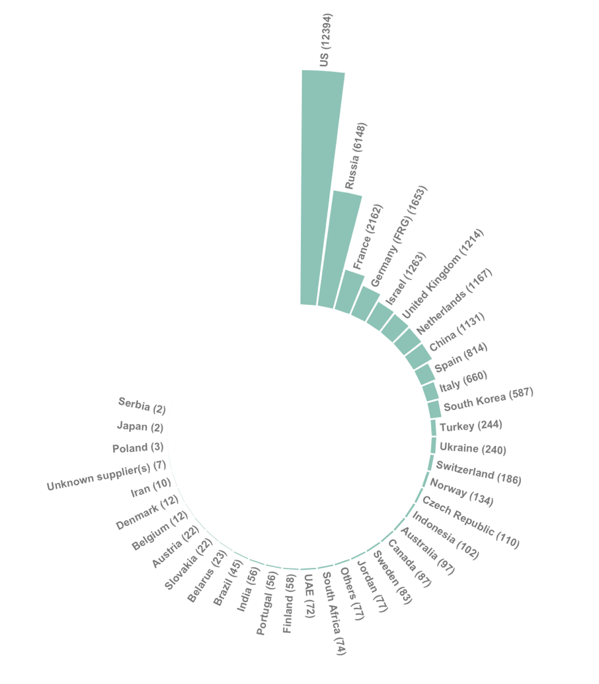
Who sells more weapons ?

Slide 31
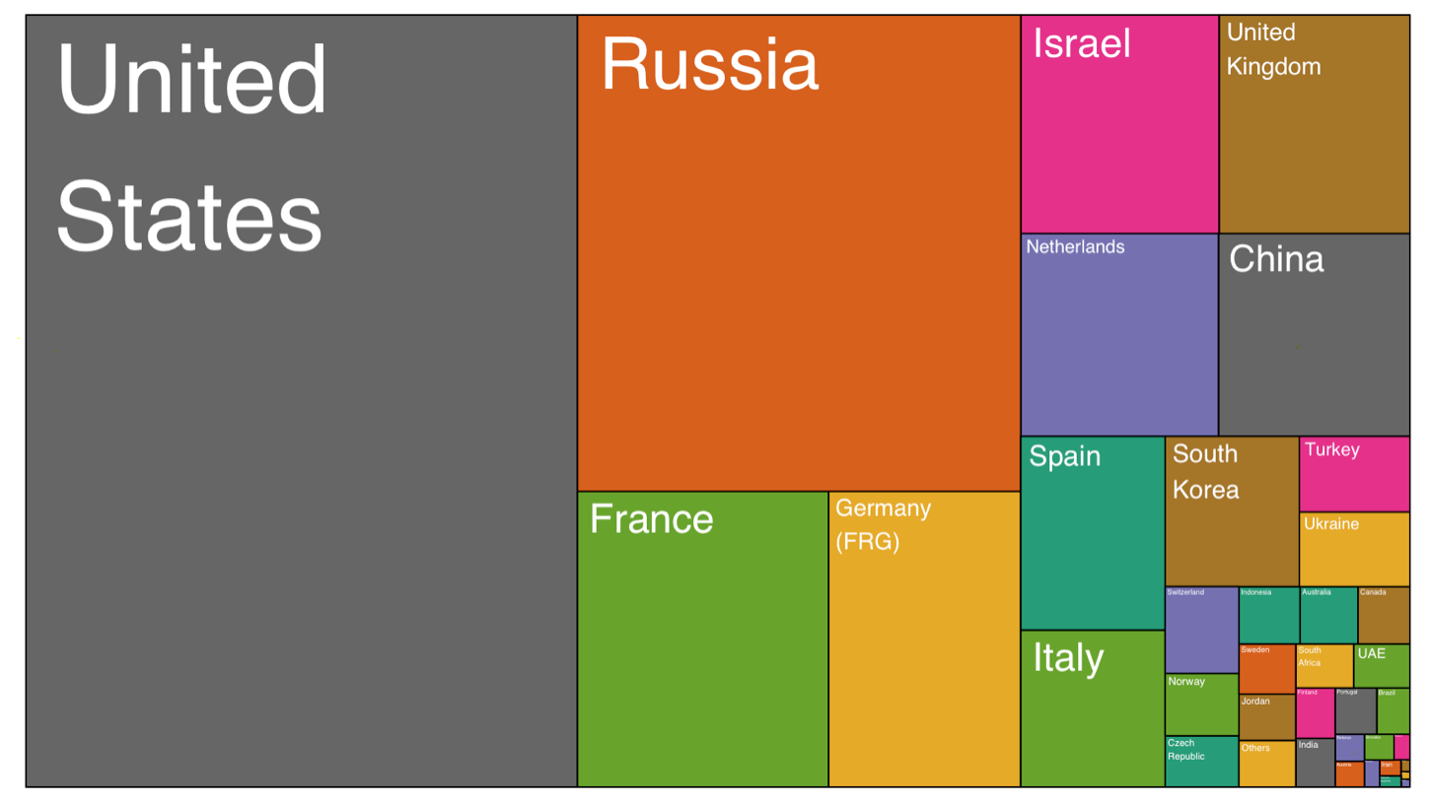
Who sells more weapons ?

Slide 32
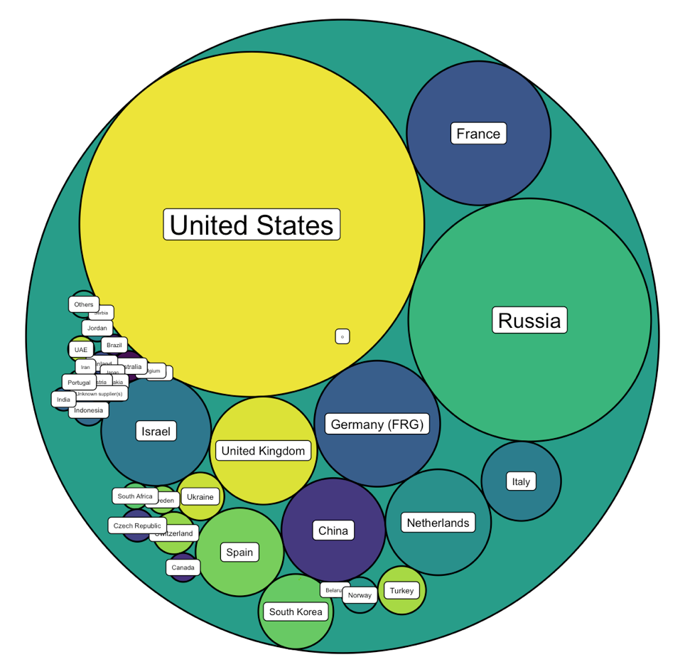
Who sells more weapons ?

Slide 33







Who sells more weapons ?

Slide 34
Chart Decision
?

Slide 35
Eye catching / accurate
Question
Exploratory vs Explanatory
Chart Decision
Interactive or Static?
Who’s reading ?
Data itself

Slide 36
Examples

Slide 37
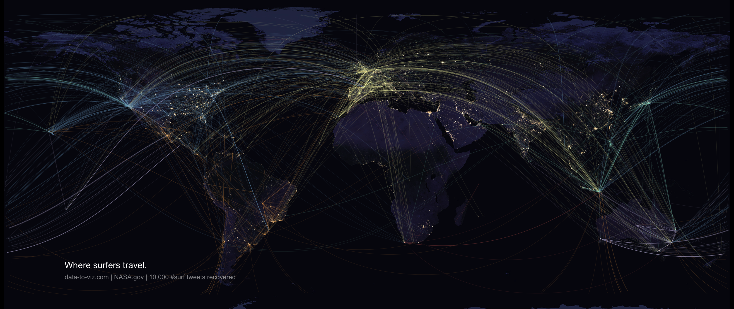

Slide 38
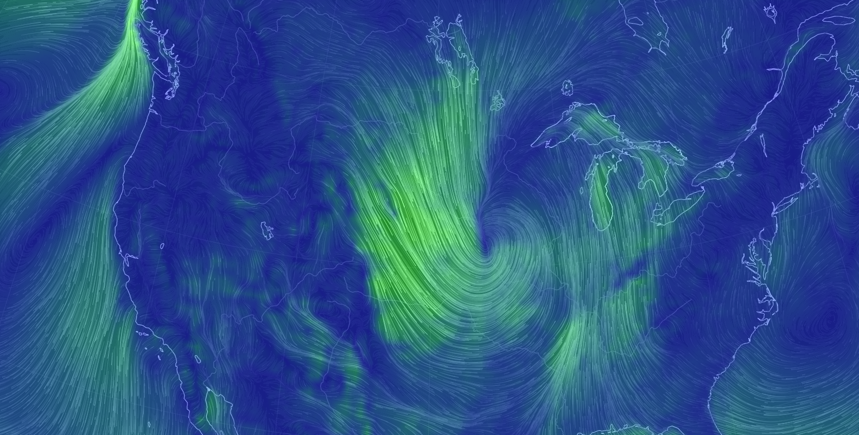
Notes:
Dinéusorus

Slide 39
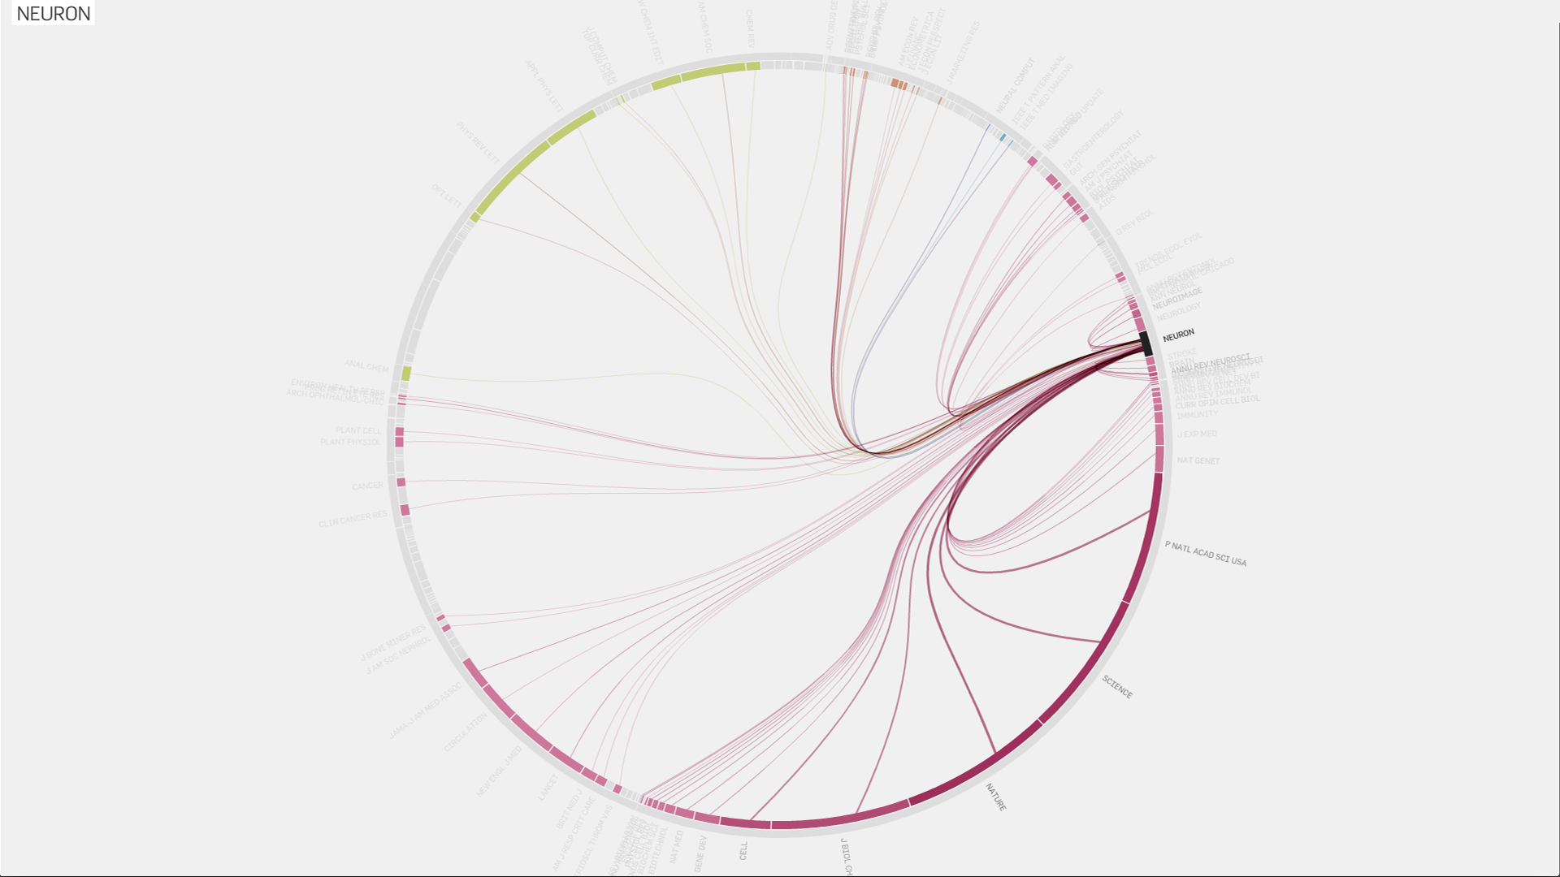
Truth-and-beauty.net
Notes:
Dinéusorus

Slide 40
How

Slide 41
See the chart maker directory by visualisingdata.com
Data Wrapper
R
Flourish
Python
Tableau
SAS
Jump
MatLab
Excel
QlikView
Julia
D3
Easy
Limited
Hard
Flexible
* Far from being exhaustive

Slide 42

See the chart maker directory by visualisingdata.com
Data Wrapper
R
Flourish
Python
Tableau
SAS
Jump
MatLab
Excel
QlikView
Julia
D3
Easy
Limited
Hard
Flexible
* Far from being exhaustive

Slide 43

R-graph-gallery.com
Python-graph-gallery.com
D3-graph-gallery.com
Notes:
Demo d3-graph gallery.com

Slide 44




Thanks
Yan.holtz.data@gmail.com
www.yan-holtz.com
Slides:
yan-holtz.com/teaching
@R_Graph_Gallery
github.com/holtzy

